Slide 1
The Metaverses and the Path to 6G
Dr Volker Ziegler
Senior Technology Advisor, Chief Architect
July 10, 2023
6G Wireless Foundations Forum
SOPHIATECH CAMPUS

Slide 2
Agenda
Opportunity of the metaverses and requirements
6G timeline and focus
Six key technology areas
6G collaborative advantage

Slide 3
Key trends shaping the world of 2030
Driving requirements for the ecosystem and the network
Deglobalization & techno-nationalism
Metaverse
Digital-native, evolved experiences
Cyberthreats & cybersecurity
Sustainability
Service-optimized connectivity
New purchasing priorities
Cloud
AI/ML
Web3
Socio-economic & geopolitical
Technology
User needs
Industry-Enterprise-Consumer-Developer

Slide 4
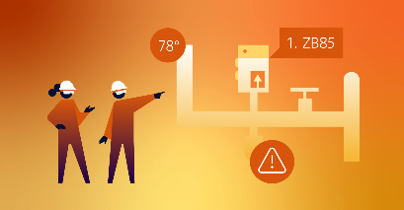
We have a clear and definitive vision of the metaverse opportunities
Concepts developed through Bell Labs Research frame this vision
Metaverse enablers
Metaverse opportunity areas
Human Augmentation
Digital-Physical Fusion
Consumer Metaverse
Extensions that enable people to interact with and within the digital world
Dynamic, connected representations of real-world things in the digital world
Enterprise Metaverse
(IT*-centric)
Industrial Metaverse
(OT*-centric)
* IT: Information Technology
OT: Operational Technology

Slide 5
“Holodeck” – are we ready ?
Network throughput (upstream) and latency require boost for XR / metaverse
Up to 4x boost required in uplink to provide guaranteed 20 Mbps
Up to 4x latency reduction required to provide guaranteed 10 ms
Edge Cloud for lower power, high performing XR devices with split processing.
Guaranteed uplink (95%) data rate in Mbps
Guaranteed latency (95%) in ms
14
Edge Cloud
28
26
Target
10-50 ms
22
25
Target
10-20 Mbps
32
36
APP server
39
38
66
5G
5.0
6.1
4.9
5.4
4.5
4.8
5.1
4.7
4.2
5.4
4.4
4.6
5.5
74
3.8
4.1
4.1
84
78
XR stack
120
130
4G
5G NSA
5G SA
4G
5G NSA
5G SA
Source: Nokia, crowd-sourced data collected from Tutela in December 2022.
Latency measured as roundtrip time to Amazon, Google or Akamai CDN test server

Slide 6
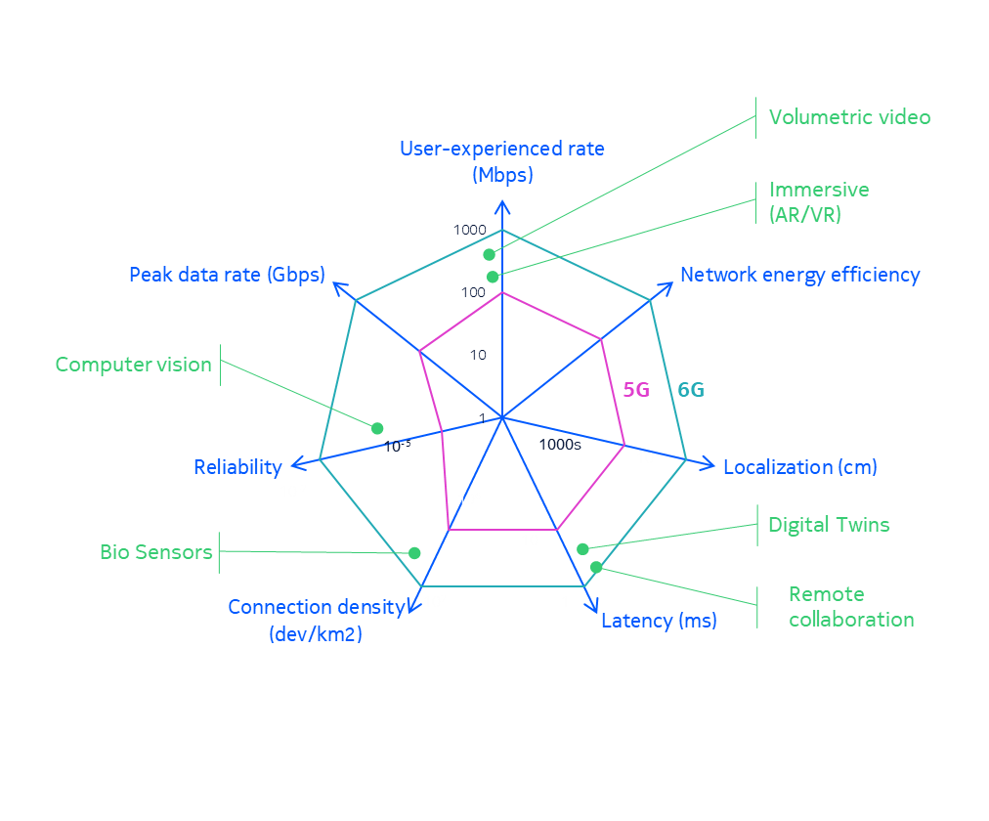
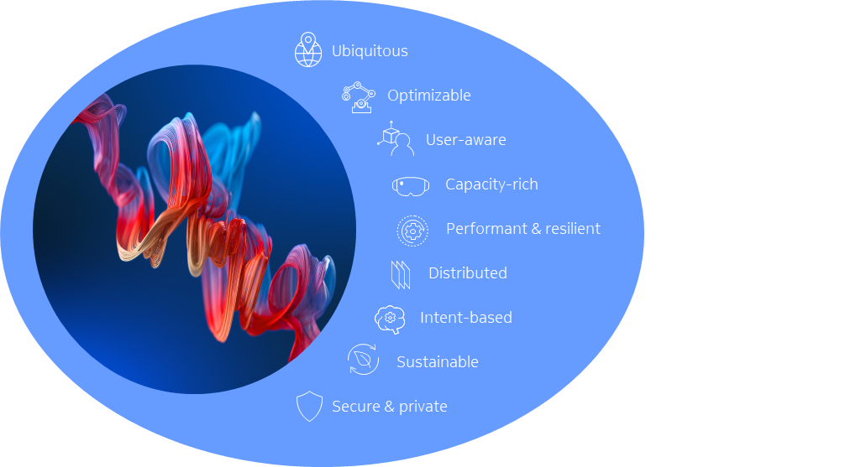
This transformation will require new network capabilities and versatile integrations
New service needs
Network characteristics

Slide 7
Agenda
Opportunity of the metaverses and requirements
6G timeline and focus
Six key technology areas
6G collaborative advantage

Slide 8
The journey has already begun
Evolutionary path with revolutionary technology
5G
5G-Advanced
6G
High quality video
(4K-8K)
XR - fully immersive
user experience
Holographic
transmissions
Object driven
digital twinning (e.g., an engine)
Large scale digital
reconstruction (e.g., a vertical farm)
Broad based digital twins
with synchronous
updates (e.g., smart city)
Data communication and control
Provide precise location and timing services that complement GNSS
Network with a 6th sense
2019
2025
2030

Slide 9
Timing is everything – “Engage”
Release 21 is the key focal point
WRC-23 12/2023
WRC-27 12/2027
Industry Alignment
Requirements, eval Critera.
Proposals
IMT-2030 Spec
5G-Adv. Standardization
6G pre-standard
6G specs 6G specs 6G specs baseline ph2 ph3
6G study
6G requirements
Release 18
Release 19
Rel-20
Release 21
Release 22
Rel-23
2022
2023
2024
2025
2026
2027
2028
2029
2030 Launch
6G workshop 03/2025
6G specs 09/2028

Slide 10
Release 21 – the key focal point
Highly optimized for XR+MBB
3D networks: Terrestrial + Satellites
Low Power LAN & WAN IoT; Lean(er) Industrial IoT
Architecture
Standalone 6G
Smooth evolution
Carrier Aggregation and Multi Radio Spectrum Sharing
Air Interface
OFDM + DFT-s-OFDM
Extreme MIMO @ 7-15GHz
Duplexing
6G
Extreme Energy Efficiency
Zero traffic => zero energy
Hybrid beamforming
Smart scheduling
AI-native
Collaborative two-sided AI
Deep RX
Deep scheduler

Slide 11
Agenda
Opportunity of the metaverses and requirements
6G timeline and focus
Six key technology areas
6G collaborative advantage

Slide 12
Bringing future to life
Six key technology areas for the 6G essential infrastructure
Spectrum technologies
Security, trust and privacy
AI-native air interface
6G
Cognitive, automated & specialized architectures
Network as a sensor
Extreme connectivity
Notes:
Nokia Bell Labs has identified six key technologies that will be vital components of future 6G networks, in a white paper published two years ago
Communications in the 6G era
https://www.bell-labs.com/institute/white-papers/communications-6g-era-white-paper/
6G technology e-book: https://www.bell-labs.com/research-innovation/what-is-6g/6g-technologies/

Slide 13
6G AI native air interface
6G
The roadmap to learning radios
Transmitter
Receiver
Encoding
Symbol Mapping
Modul-ation / Wave-form
Sync.
Channel Esti-mation
Equali-
zation
Symbol Demap-
ping
Deco-
ding
5G
The classical architecture
5G-Advanced phase 1
ML replaces/enhances individual processing blocks
ML
ML
ML
ML
ML
5G-Advanced phase 2
ML replaces multiple processing blocks
ML
ML Deep RX
ML
6G
ML designs part of the PHY itself
ML Deep TX
ML
Deep RX
Notes:
AI/ML will provide a new foundation for air interface design and optimization, enabling self-optimizing transmitters and receivers, cognitive spectrum use and context awareness.
What is this research about?
Machine learning is used in everything from image recognition and classification to natural language processing and robotic systems. But what could these data-driven, trained systems mean for future mobile networks? What if we could engineer radios that could adapt their signalling schemes to achieve the best performance for any situation, learning from one another and effectively thinking for themselves? We believe a dynamic AI/ML-defined native air interface will be a key component of 6G networking in the future.
What are the main use cases?
Private networks could really benefit from these flexible radios. A learning network in a factory could be configured to support industrial sensors at one moment then rapidly reconfigure to support robotic systems or video surveillance. These radios make smart choices – moving between spectrum bands, reconfiguring signal paths and modulation schemes as the specific application demands. With the ability to handle scenarios that engineers haven’t even considered, a flexible interface that autoadapts could very well change the face of network optimization.
What are some of the advantages of an AI/ML-defined native air interface?
• A learning radio could dynamically learn and set up bespoke waveforms, constellations, and pilot signals that make more efficient use of available spectrum, resulting in improved performance.
• AI/ML-based physical layer solutions can enhance the energy efficiency of 6G networks by achieving as much as a 50% reduction in transmit power over 5G for the same bandwidth and data rate.
• On the MAC layer, AI/ML could customize signalling and access schemes, which could adapt to the service needs automatically.
• A learned air interface could embrace hardware non-linearities and limitations and fully adapt to any target platform.
• AI/ML could choose among all the myriad of parameters in a radio network far more effectively than a human.
• A learned AI/ML air interface could transform how R&D is done by fundamentally altering the way algorithms are designed

Slide 14
Network as a sensor
6G
Joint communication and sensing (JCAS)
JCAS Access Points
Sensing-only Access Points
Sensing
Communication
14
© 2023 Nokia
Notes:
Sensing is one of the big transformations we anticipate in the move to 6G networks. In this network, radio signals transmitted by base stations and user devices don’t just carry data. Those wireless propagation channels also become a source of situational information. The network can compare received signals reflected off objects against their original transmissions to gather information about those objects. Those received signals can tell us not just about the presence of an object, but it can determine its type and shape, its relative location and velocity, and even its material properties.
What is this research about?
6G will give our networks the ability to sense. By bouncing signals off objects, the network will determine what’s there, how things are moving – and potentially even what they’re made of. The network becomes our sixth sense, extending our awareness beyond our immediate surroundings.
This sensing capability can be used to map a digital version of the physical world. By interacting with this ‘digital twin’, we could extend our senses to every point the network touches.
What are some possible use cases?
• The network could detect if a vulnerable person has fallen and even “hear” their heartbeat, alerting emergency responders about possible trauma.
• We could avoid traffic accidents by sensing unseen cars driving around a corner.
• We could interact directly with machines and robots remotely, seeing what they see, hearing what they hear, while directing their actions through simple hand gestures captured by the network.
• Network sensing could be used to provide security in places where cameras aren’t available or allowed, and it could be used to augment camera networks in foggy or dark conditions.
What are the technologies required for network sensing?
Developing this sixth sense will require the support of myriad developing technologies, from AI/ML to joint communication and sensing design. It will also require new spectrum. With near THz frequencies, we can build larger antenna arrays with more narrow beams, achieving greater angular precision. With wider bands, we also get better time resolution of the back reflected signal, and hence better distance accuracy. The network will perceive radio frequency reflections as images similar to the visual images humans perceive with their eyes. Other factors key to network sensing will be 6G’s greater density of cells, advanced MIMO beamforming techniques and AI-driven signal processing capabilities

Slide 15
Extreme connectivity
6G
End-point is a critical sub-network with specific requirements
In-vehicle
In-body
Cell capacity
100
Mobile broadband (reference)
10
Pacemaker
1
Localization accuracy
Haptic sensors/ actuators
0.1
1/Latency
In-production control
Service availability
1/Jitter
Notes:
5G has done a tremendous job in improving reliability of wireless communication for a plethora of applications and services, but there is still work to be done before 5G can replace the inflexible, yet trustworthy, cable for all services.We believe 6G will make it possible to eliminate wired communication entirely, at least for short-range transmission. In our 6G research, we are exploring how wireless can be used as an invisible cable, achieving the same level of latency and reliability as dedicated wires. This can unleash new possibilities for wireless communication such as replacing the highly sensitive internal networks in vehicles while maintaining the same service levels, lowering vehicle weight and reducing maintenance costs. A 6G network could enable flexible modular robots in an industrial IoT scenario. It could even keep our hearts beating and our limbs moving by providing the critical link in healthcare applications such as cardiac pacing or muscle control for disabled patients.
In our 6G vision, all highly sensitive connectivity should be in-X, meaning it is provided by highly specialized radio cells installed within the entity where the application runs, for instance in robots, production modules vehicles and even human bodies. We say subnetwork, because these specialized radio cells must be able to operate autonomously even when out of coverage of an overlay wide area network. These cells support life-critical services that cannot depend on connections to the overlay network, though they can benefit when those connections are available.
What is this research about?
6G will permit wireless to be used as an invisible cable, achieving the same level of latency and reliability as dedicated wires to support life-critical services. We call these extreme connectivity systems in-X subnetworks.
What are some possible use cases?
In-X subnetworks could enable flexible, modular robots in industrial IoT. They could provide the links between actuators on robot arms, giving them much broader ranges of motion as well as allowing groups of robots to coordinate high precision operations.
These subnetworks could replace the cables that link the life-critical functions in our vehicles, for instance braking, acceleration and assisted-driving sensors. This could potentially lower vehicle weights and reduce maintenance costs while maintaining the same level of service reliability.
In-X could keep our hearts beating and our limbs moving by providing the critical link in healthcare applications such as cardiac pacing or muscle control for disabled patients.
What are the main challenges?
A large amount of spectrum is needed for making the in-X concept a reality because more spectral bandwidth allows for more robust connections, which in turn provides higher fault tolerances.
Wireless is a shared medium, prone to detrimental effects such as fading, noise and interference – all of which could compromise the integrity of an in-X subnetwork connection.
New updated system design and configuration are needed to enable 6G to support use cases with extreme requirements such as latency loop cycles below 100 μs with nine times reliability and extremely high device density for future IoT deployments.
Which technologies could help to overcome these challenges?
In our vision, all highly sensitive connectivity should be in-X, meaning it is provided by highly specialized radio cells installed within the entity where the application runs.
These specialized radio cells must be able to operate autonomously, even when outside the coverage of an overlay wide area network. They would keep critical traffic local, minimizing latency.
In-X subnetworks would be based on a proactive radio design that follows an act-before-fail approach exploiting channel hopping and packet repetition. A smart radio resource management would then counteract interference in very dense scenarios, providing robustness against non-cellular interference created by malicious attackers like jammers.

Slide 16
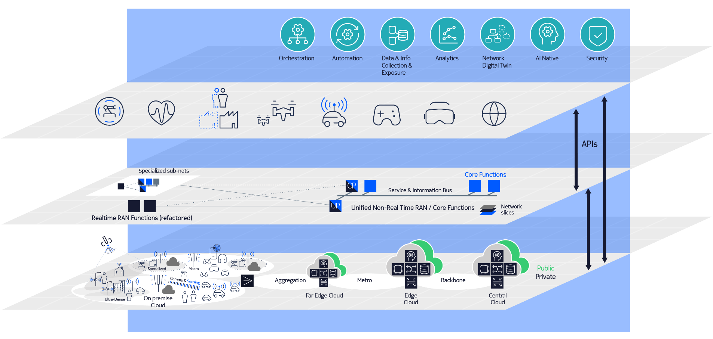
Cognitive, automated and specialized architectures
6G
Notes:
What is this research about?
Networks have traditionally been measured according to their speed, capacity and latency, but the 6G era will require a new architecture for a new set of values. Sustainability, digital inclusion, security and privacy are becoming the new key metrics for networking.
Our research explores the potential for a new architecture with seven distinct design criteria: cloud platform, simplification and sustainability, flexibility, programmability, specialization, robustness and security, and native integration of AI/ML capabilities.

Slide 17
6G security and trust
6G
Addressing the ever-expanding threat vectors
Threat vectors
Technology enablers
Multi-stakeholder supply chain & run time environment
Mix of open source and multi-vendor SW, complexity
Quantum safe systems, Quantum key distribution
Trusted execution and systems integrity
Het-Cloud
(public, private, hybrid, distributed)
Authentication at scale
Data privacy
Open Interfaces & disaggregation
Secure AI/ML operations
Millions of sub-networks
Ultra-fine grain threat security responses
AI assisted security monitoring and audit
Billions of
endpoints
Notes:
The number of threats is increasing significantly due to the reasons mentioned on the left side. Especially the billions of devices and many subnetworks of different sources , and also microservices, e.g., from open source, cannot be trusted. Open interfaces allow for more flexibility, but also open up more opportunities to attack the system. Clouds are better trusted, because that is in the hands of big companies whose reputation depends on a secure data center infrastructure.
Different technology enablers are therefore essential to enable trusted services on a zero-trust infrastructure, e.g.
Creation of a trusted execution environment with flexible anchors of trust
Mutual authentication between interacting entities at scale
Automated operation and orchestration enabled by AI/ML, or also the auto-creation of SW, are expected to enhance security, because those approaches minimize interrupts for human intervention and hence also minimize opportunities for malicious human intervention.
AI-assisted monitoring allows for detection of malicious anomaly behavior and automated response to the attack.
Privacy preserving technologies such as homomorphic encryption will allow for handling data streams without the need to decrypt its content.
Quantum computing is often mentioned in relation to security, because future quantum computers that are stable and big enough will be able to rapidly decrypt today’s codes. Quantum-safe data (which are often stored for >10 years) is therefore needed such that they cannot be decrypted by future quantum computers.
Quantum mechanical principles are also used for Quantum Key Distribution over fiber or free-space optical links (already used for secure data exchange in govt. and banking applications)
What is this research about?
We are researching a security vision and security technology enablers for the 6G era that achieve the highest benchmarks for privacy and trust. 6G will bring new capabilities and novel performance attributes to the network and enable diversity of new use cases and applications. But unless consumers, businesses and industries are comfortable that these networks and applications are secure, private and trustworthy, they will never embrace them.
Why is this research important?
The 6G world will bring holographic telepresence, autonomously collaborating robot systems, massive digital twinning, the digital transformation of our workplaces and even enhanced personal health monitoring. It’s clear that security and privacy will be of paramount importance. With billions more connected devices and sensors, and millions of subnetworks operating in untrusted domains, we can expect more and new types of threats. While artificial intelligence and machine learning will help in the fight, they will also provide new opportunities for hackers.
What are some of the main challenges?
• A 6G network will be able to locate a person’s precise position in a room, as well as track their habits. Hacked bio data could be used for sophisticated fraud and extortion attempts.
• The confidentiality of business data will assume even greater importance, as business models increasingly rely on controlled access to and ownership of customer, process and business data. Ransomware attacks, corporate espionage and “deep fakes” will pose ever bigger threats in the 6G era.
• The unparalleled processing power of quantum computing will give attackers means to hack current cryptographic algorithms and dependent security procedures once thought impenetrable.
• Localized industrial and campus networks will become the norm, as will their appeal to attackers, raising the possibility of industrial and critical infrastructure sabotage that could cause considerable damage to equipment and lives.
Which technologies could help to overcome these challenges?
• Many of today’s cryptographic algorithms will need to be replaced with quantum-safe concepts. This change needs to start now, so we can protect today’s long-term archived data against future disclosure. Also, Quantum Key Distribution may provide a way to secure 6G networks and protocols.
• Anonymization and enhanced privacy-preserving technologies will help to protect our data. This includes homomorphic encryption, a technique which allows us to analyze data without disclosing it.
• Trust technologies like Trusted Platform Module and Trusted Execution Environments will attest data and system integrity as well as provide proof of data ownership anchored in silicon and hardware.
• Distributed ledger technologies such as blockchain technology will be used for tamper proof tracking of security claims like data access rights. Distributed ledger technologies provide a secure framework to simplify establishment of trust across heterogeneous operator domains and enhance 6G era use cases.
• Industrial networks will be safeguarded with measures such as physical layer protection and jamming detectors. They will have countermeasures like directional null steering for uplink jamming mitigation and frequency hopping.

Slide 18
Agenda
Opportunity of the metaverses and requirements
6G timeline and focus
Six key technology areas
6G collaborative advantage

Slide 19
Creating the future through research collaborations
Working with academia and research institutions
Academic partnerships on 6G research
A landmark industry event created by Nokia and the NYU WIRELESS research center to charter the technical future of the wireless industry.
Nokia is a co-creator member of University of Oulu 6G flagship program.
Nokia is a member of 6G@UT, a funded collaboration between industry and University of Texas at Austin.
Notes:
Nokia and the NYU wireless research center have hosted an annual Brooklyn Summit since 2014, one of the most distinguished gatherings that has chartered the technical future of the wireless industry. It became Brooklyn 6G Summit in 2021.

